Slide 1
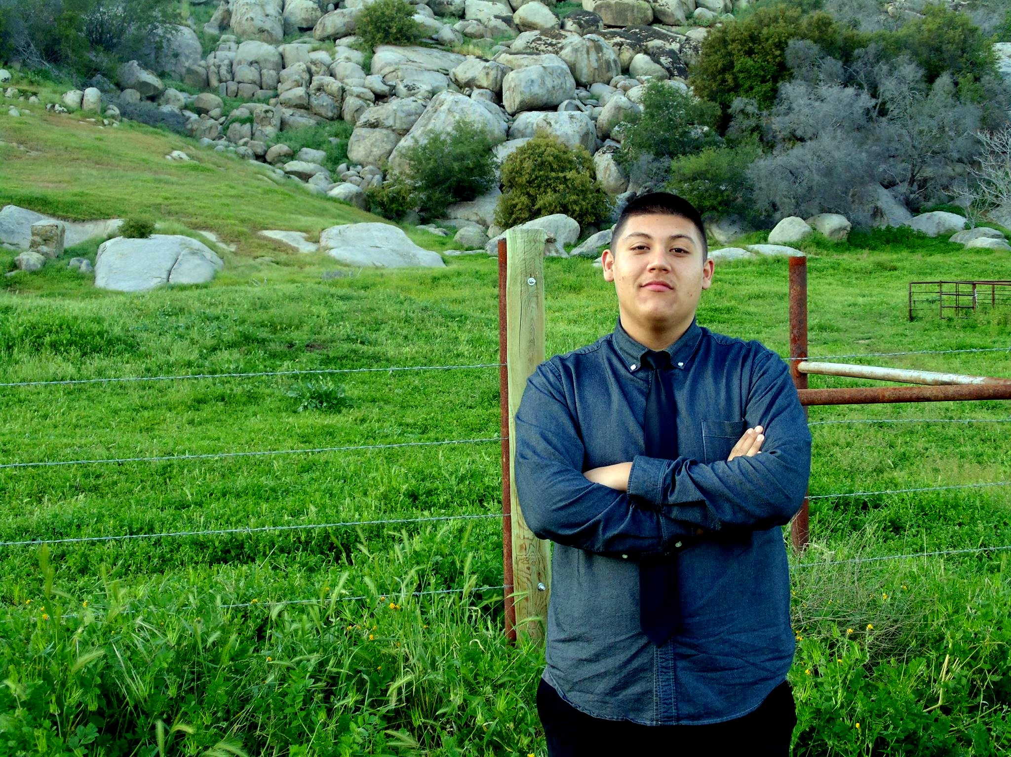
Juan Orozco-Barajas
Class of 2016
Senior Exit Interview

Slide 2
About Me
Born in Santa Maria, CA
Lindsay
Hispanic Background
I'm one of the 10%
Never been at Mrs. Moore's office
Oldest one in the Family
Love playing video games & watching soccer games

Slide 3
High School Experience
Key Club & Redzone
PBS: Helpful
Being a procrastinator
Getting prepared for the future

Slide 4
Job Shadow
Ride along; Officer Romero
Been interested in Law Enforcement
Interacted with people

Slide 5
Pathway
Spanish
Being able to be bilingual
Spanish and English are most spoken language internationally

Slide 6
Post-High School Plan
COS;Major in Business or Law enforcement
Get my Associates degree
Trying to strive for a bachelor's degree

Slide 7
Leaving Lindsay High School
Building an empire
Gained experience
Lots of memories

Slide 8
Thank you for your time any questions?

